Slide 1
CRM DATA ANALYTICS
__________________________________
Team Members:
__________
Nehal
Spandhana Bhaskar
Guttappa Balappagol
M. Kiraneshwar
Pratik
Parnika Vartak
Mentor: Hafeez
_____________________________________

Slide 2
Agenda
Introduction: The CRM Analytics dataset offers a comprehensive view of the sales pipeline, including opportunity stages, conversion metrics, and deal timelines. By studying this data, businesses can evaluate performance across multiple KPIs such as revenue growth, pipeline conversion, and seasonal closing patterns. This project leverages Excel, SQL, and Power BI to transform raw transactional data into meaningful insights.
KPI insights: Our analysis of the CRM dashboard highlights key performance insights. Active pipeline values stand strong at 35M, though conversion rates point to significant early-stage drop-offs. Seasonal data reveals that closing activity scales up aggressively toward Q4, reflecting notable back-half buying behavior. Additionally, a strong concentration of revenue relies heavily on a single opportunity type, which highlights areas for portfolio diversification.
Final Recommendations: Each KPI chart will be reviewed individually. For every metric, we provide an Observation, a Suggestion, and a Conclusion to deliver actionable business strategies.

Slide 3
Project Overview
Utilized the CRM Analytics Dataset, consisting of relational tables stored in structured database/CSV formats.
​Worked with key tables such as Opportunity, Lead Table, Account Table, Opportunity Product, and User Table to establish a comprehensive data model.​
Performed data engineering and analysis on structured sales pipeline data using SQL and Power BI (DAX).​
Extracted insights related to sales representative performance, pipeline velocity, quarterly seasonality trends, and opportunity conversion rates.

Slide 4
Opportunity KPI Insights
About Chart: 1st KPI: Represents the total potential revenue in the pipeline. 2nd KPI: Shows the number of deals currently being pursued. 3rd KPI: Indicates how many leads successfully turn into closed deals. 4th KPI: Reflects the percentage of opportunities that result in successful closures. 5th KPI: Highlights the proportion of opportunities that end unsuccessfully.
Observation: Indicates a very high strong potential revenue, but it’s only meaningful if opportunities are actively progressing. A large number of opportunities shows strong market engagement, but it risks spreading sales efforts too thin. Extremely low conversion suggests a gap between lead generation and deal closure. Nearly half of pursued deals are won, which is a solid performance benchmark. A significant portion of opportunities are lost, highlighting competitive or process challenges.
Suggestion: Prioritize high‑value deals with structured follow‑ups and allocate resources to accounts contributing most to this figure. Segment opportunities by value and stage to ensure effort is directed toward the most promising deals. Reassess lead qualification criteria and strengthen nurturing strategies to improve conversion. Analyze winning deal patterns (industry, product, approach) and replicate them across other opportunities. Conduct win/loss analysis to identify recurring reasons for losses and address them proactively.
Conclusion: The pipeline is healthy, but conversion focus is essential to realize this expected revenue. Volume is strong, but strategic prioritization will maximize efficiency and outcomes. Current conversion is weak; refining lead quality and sales processes is critical. Win rate is healthy, but scaling best practices can push it even higher. Reducing loss rate is as important as increasing wins; targeted improvements can unlock hidden revenue.

Slide 5
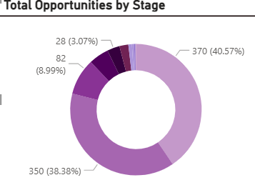
KPI Insights(Opportunity)
KPI 6 :-OPPORTUNITY BY STAGE
About Chart: This donut chart visualizes how your total opportunity volume is divided percentage-wise across the different developmental phases of your sales pipeline.
Observation:The largest visual segment dominates at 40.57% (370 opportunities), while another substantial phase holds 38.38% (350 opportunities). A small sliver sits at just 3.07% (28opportunities). This shows an extreme concentration of deals clustered in two primary stages.
Suggestion:Define rigid, milestone-based "exit criteria" for the two heavily congested stages. Do not allow reps to manually advance a deal until the prospect has taken a verified, high-intent action.
Conclusion:The pipeline's volume is bottlenecked heavily inside specific stages. Clearing these massive operational blocks will smooth out the sales cycle and create a more predictable revenue flow.

Slide 6
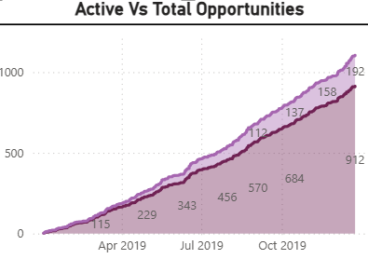
KPI-7 :-ACTIVE VS TOTAL OPPORTUNITIES
About Chart: This dual-line trend chart maps the chronological growth of total cumulative opportunities created against the subset of active, ongoing opportunities throughout 2019.
Observation:The chart shows a steady, continuous upward climb from April 2019 through October 2019, with active opportunities scaling up to a high point of 912. The close alignment of the lines shows that active volume is driving total volume growth.
Suggestion: Ensure your sales velocity keeps up with this rapid incline. Introduce automated customer journeys or pipeline management triggers to make sure deals continue to move forward as numbers scale.
Conclusion:Pipeline growth is accelerating at a highly consistent, impressive pace over time. Maintaining strict operational control over this expanding volume will ensure that growth translates directly into cash.

Slide 7
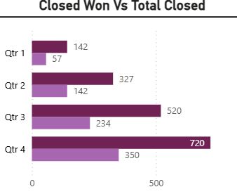
KPI-8 :-CLOSED WON VS TOTAL CLOSED
About Chart: This horizontal bar chart tracks sales volume on a quarterly basis, contrasting the number of successfully won deals against total closed deals for Q1 through Q4.
Observation:Closed volume increases dramatically as the year progresses. It peaks heavily in Q4 with a massive 720 total closed deals (and 350 won), compared to a quiet Q1 with only 147 closed deals (and 57 won).
Suggestion:Plan organizational resources around this intense back-half seasonality. Ensure that legal, onboarding, and customer success teams are heavily supported in Q3 and Q4 to handle the massive influx of closings without delays.
Conclusion:Sales velocity is highly back-heavy and seasonal. While the massive year-end push is incredibly productive, working to stabilize deal closures during Q1 and Q2 will establish steadier revenue.

Slide 8
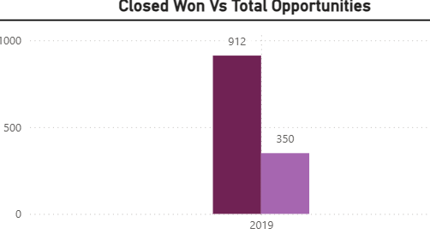
KPI-9 :-CLOSED WON VS TOTAL OPPORTUNITIES
About Chart: This high-level vertical bar chart compares the total macro pool of opportunities generated throughout the year against the exact volume that made it to "Closed Won“.
Observation:For the year 2019, out of a towering cumulative pool of 912 total opportunities, a total of 350 opportunities were successfully converted to Closed Won.
Suggestion:Use this fixed yearly ratio (350 wins out of 912 opportunities) as a foundational planning benchmark. If next year's growth target demands 500 wins, use this chart to prove to leadership that total opportunity sourcing must scale proportionally.
Conclusion:This macro view provides a vital reality check on overall team capacity, showing exactly how much raw funnel input is required to generate your final output of successful wins.

Slide 9
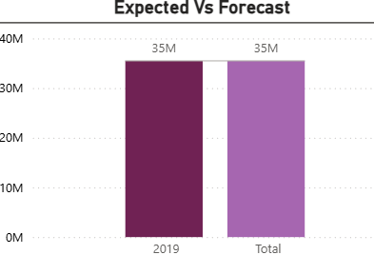
KPI-10 :-EXPECTED VS FORECAST
About Chart: This chart compares the mathematically weighted "Expected Amount" of the pipeline against the baseline sales forecast goal for the 2019 period.
Observation:Both the Expected column and the Forecast column stand perfectly identical at 35M for the year 2019 and the overall total.
Suggestion:Maintain this elite forecasting precision by continuing to audit CRM pipeline hygiene. Ensure sales reps regularly update deal closure probabilities so that data remains completely reliable.
Conclusion:Pipeline forecasting is highly accurate and completely aligned with targets. This exact 1:1 match gives executive leadership absolute confidence when budgeting and allocating company resources based on future revenue projections.

Slide 10
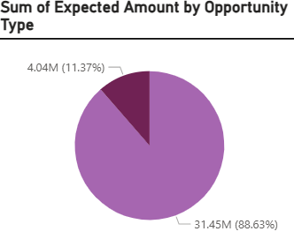
KPI-11:-SUM OF EXPECTED AMOUNT BY OPPORTUNITY TYPE
About Chart: This pie chart breaks down the expected financial value of the pipeline based on the underlying category or classification of the opportunity.
Observation:The chart is overwhelmingly dominated by a single category, which commands a massive 88.63% (totaling 31.45M) of the pipeline, leaving the secondary category at just 11.37% (4.04M).
Suggestion:Mitigate systemic risk by diversifying your revenue streams. Incentivize the sales team to cross-sell, upsell, or pursue the minority opportunity category to decrease reliance on a single sector.
Conclusion:While having a dominant 31.45M revenue driver shows fantastic specific strength, it leaves the company vulnerable to market shifts. Expanding the minor category will build a much safer, more resilient business foundation.

Slide 11
Leads KPI Insights
About Chart: 1st KPI: Represents the overall pool of prospects generated. 2nd KPI: Shows the potential revenue value from successfully converted leads. 3rd KPI: Indicates the efficiency of turning leads into closed deals. 4th KPI: Reflects the number of accounts that have been successfully converted into customers. 5th KPI: Highlights the total opportunities that resulted in successful conversions.
Observation: A large pool of leads indicates strong market reach but also requires careful qualification. High potential revenue reflects strong deal values among converted leads. Moderate conversion rate suggests room for improvement in lead nurturing. Nearly 500 accounts converted shows meaningful customer acquisition. Strong opportunity conversion reflects effective deal closure practices.
Suggestion: Implement lead scoring to filter high‑quality prospects and reduce wasted effort. Prioritize nurturing high‑value accounts to ensure revenue realization. Strengthen sales funnel touchpoints and personalize engagement strategies. Build long‑term relationships with these accounts to maximize lifetime value. Analyze successful opportunity patterns and replicate across other segments.
Conclusion: Lead volume is strong; quality focus will drive better conversions. Revenue potential is robust; execution is key to capturing it. Conversion is decent but can be lifted with targeted process improvements. Account conversion is healthy; retention strategies will amplify impact. Opportunity conversion is promising; scaling best practices can boost growth.

Slide 12
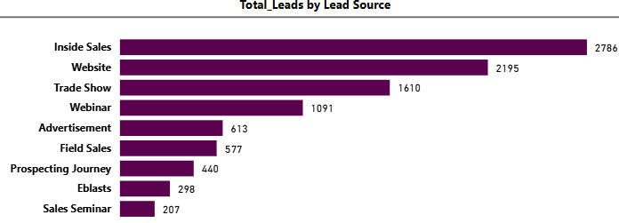
KPI Insights(Leads)
KPI 6 :-TOTAL LEADS BY LEAD SOURCE
About Chart: This chart breaks down the total volume of generated leads across various marketing and sales channels, such as Inside Sales, Website, Trade Shows, Webinars, and Advertisements.
Observation:Inside Sales is the top-performing channel with 2,786 leads, closely followed by the Website at 2,195 leads. Outbound and digital channels are generating the highest volume, while event-based channels like Sales Seminars (207) and Eblasts (298) contribute the least..
Suggestion:Double down on financing and resources for Inside Sales and Website optimization to scale lead volume further. Concurrently, re-evaluate the ROI of lower-performing channels like Sales Seminars to see if that budget can be reallocated to digital avenues.
Conclusion:Inbound web traffic and proactive internal sales development are the primary engines powering your pipeline. Maximizing these two dominant channels ensures a highly predictable flow of raw leads into the top of your funnel.

Slide 13
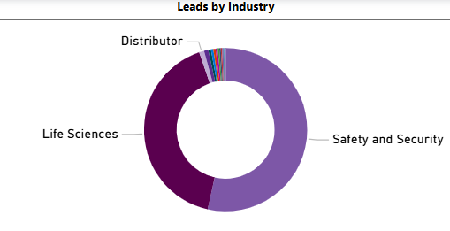
KPI 7:-LEADS BY INDUSTRY
About Chart:This donut chart visualizes the industry sector distribution of your incoming leads, identifying which corporate verticals are most engaged with your offerings.
Observation:The pipeline is heavily consolidated between two massive industry sectors: Safety and Security and Life Sciences, which together make up nearly the entire chart, while fields like Distributor represent a tiny fragment..
Suggestion:Equip sales teams with specialized, industry-specific case studies and messaging tailored strictly to Safety, Security, and Life Sciences buyers. To build a more resilient pipeline, launch exploratory campaigns to see if other industries can be successfully penetrated.
Conclusion:Product-market fit is highly concentrated in two major verticals. This clear positioning allows marketing teams to run highly hyper-targeted campaigns that speak directly to the core pain points of those two primary sectors.

Slide 14
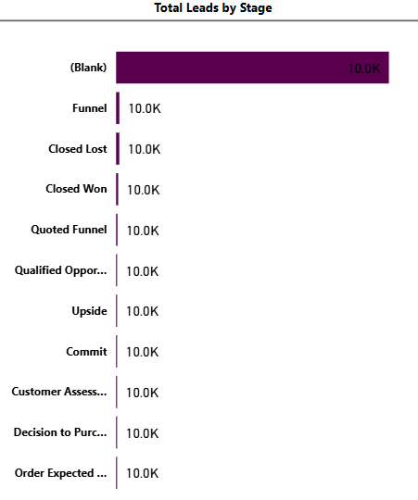
KPI 8:-TOTAL LEADS BY STAGE
About Chart: This tracking chart attempts to map how your 10K total leads are progressing through various qualification and deal milestones, such as Funnel, Closed Lost, Closed Won, Quoted Funnel, and Commit.
Observation:A large portion of data is unclassified, sitting in a "(Blank)" category at the top. Additionally, the remaining milestones show a static value of 10.0K across every single stage (Funnel, Closed Lost, Closed Won, etc.), indicating that the data model is currently displaying aggregate lead volume instead of filtered drop-offs.
Suggestion:Audit the underlying relationships and data mapping in Power BI. Connect the Lead Table fields properly to individual stage progression metrics so the visual shows a tapering, step-down funnel effect instead of duplicating the flat 10K total across all labels.
Conclusion:While the visual confirms an overall capacity of 10K total leads in the system, correcting the relationship mapping in the data model is necessary to unlock true visibility into stage-by-stage progression and conversion drop-offs.

Slide 15
Conclusion & Recommendations
Optimize Pipeline Allocation: While top-line potential is robust at 35M, resources must be strictly directed toward high-yield opportunities rather than spreading efforts thin across all 192 active accounts.
​ Institutionalize Winning Sales Playbooks: Capitalize on the strong 48.61% win rate by analyzing successful deal traits and scaling these closing techniques across the entire sales enablement framework.
​ Remediate Early-Funnel Leakage: The 0.38% conversion velocity marks a major operational gap; introduce stricter discovery stage entry criteria and aggressive lead-nurturing protocols to stabilize early drop-offs.
​Mitigate Operational Back-Loading: Address the heavy seasonal dependency where closed deal volumes peak sharply in Q4 by distributing key performance targets and pipeline support resources more evenly into Q1 and Q2.
​ De-risk Revenue Concentrations: The pipeline's structural reliance on a single opportunity type (88.63%) introduces business vulnerability; incentivize the account management teams to aggressively pursue cross-selling and account renewals to diversify portfolio exposure.

Slide 16
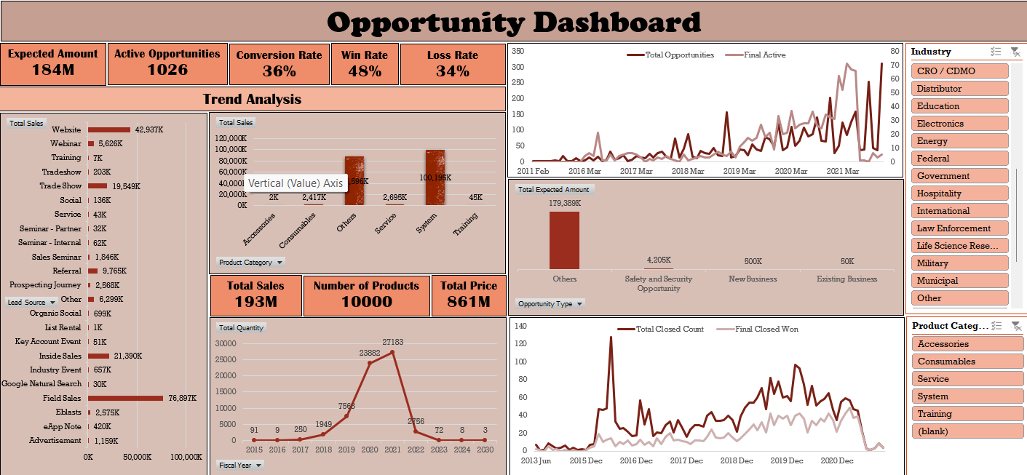
EXCEL DASHBOARD

Slide 17
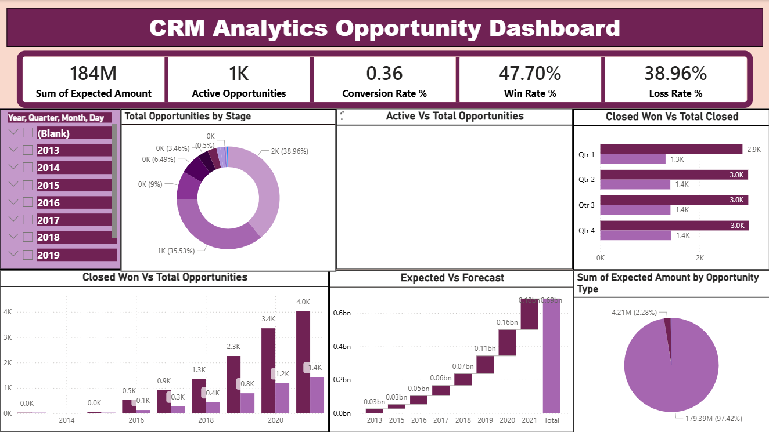
POWER BI DASHBOARD

Slide 18
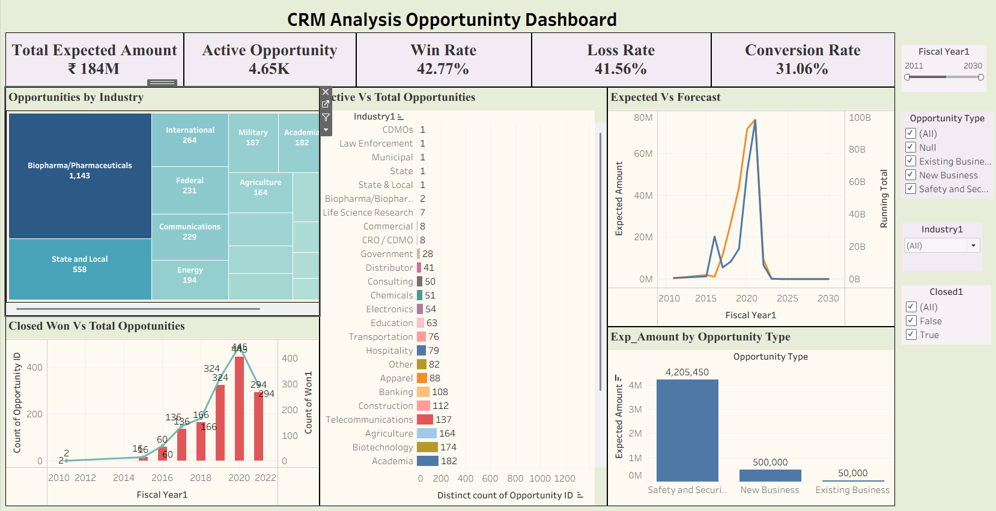
TABLEAU DASHBOARD

Slide 19

Thank you

